Slide 1
Liver transplant anesthesia –Intra-operative care
Karthik Ponnappan T MD DM(PhD) EDAIC FRCA

Slide 2
Anaesthesia for Liver Transplant
Preoperative Assessment Optimization
Intraoperative Monitoring Concerns
Postoperative Critical Care Surgical

Slide 3
Anaesthesia for Liver Transplant
Intraoperative Monitoring Concerns

Slide 4
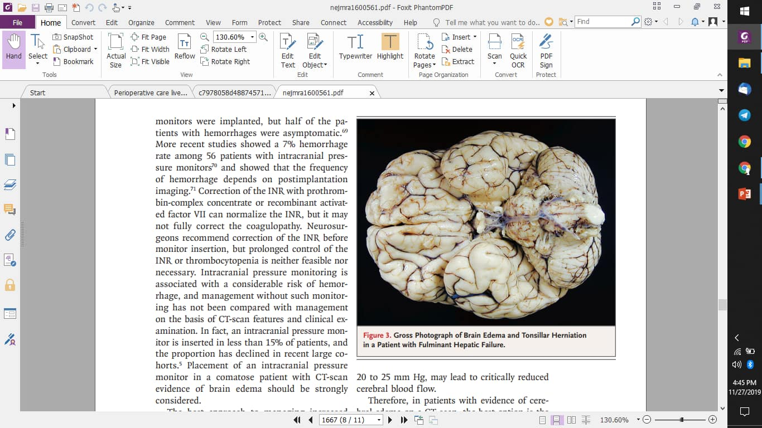
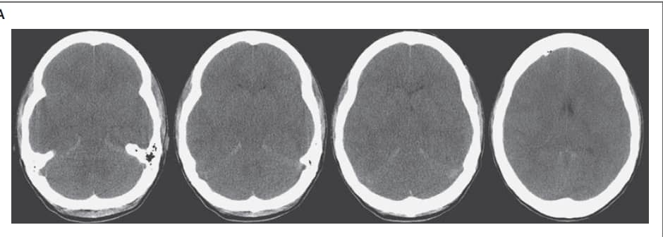
Neurologic
Cerebral edema –ALF
Pupillometry, ONSD, NIRS
patient with fulminant hepatic failure, the basal cisterns are absent, and there is loss of sulci and loss of differentiation between gray matter and white matter due to diffuse brain swelling

Slide 5
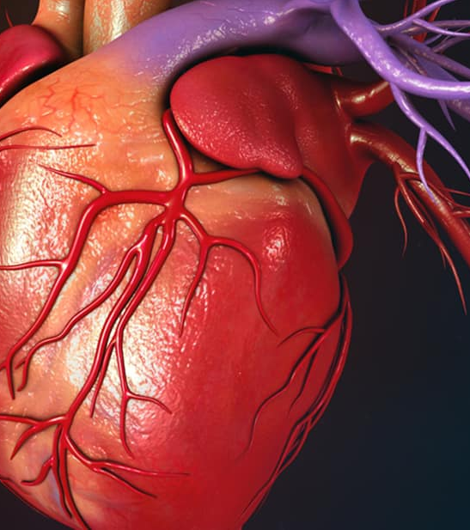
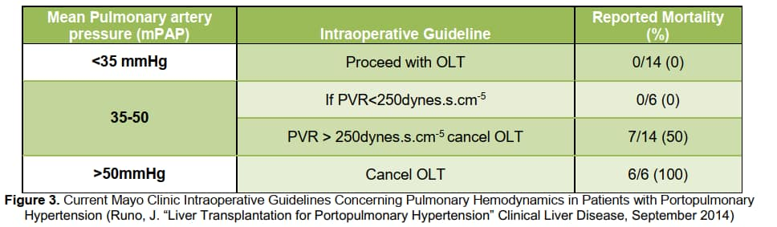
Cardiac
Portopulmonary hypertension
PA catheter

Slide 6
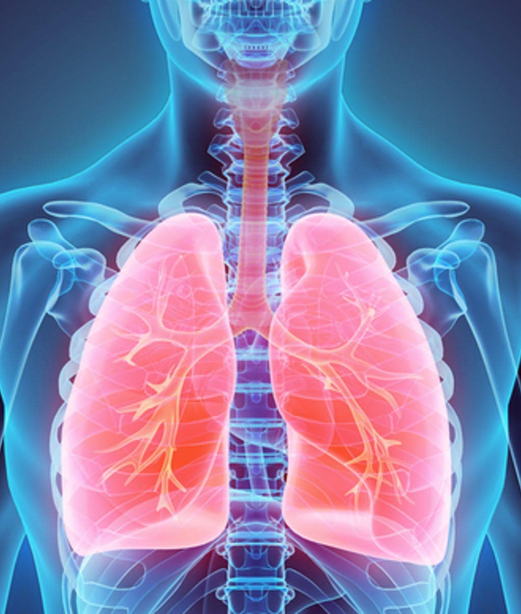
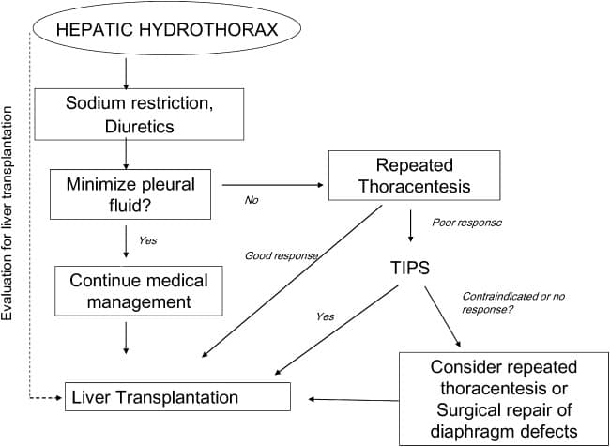
Respiratory
Restrictive Lung – Ascites
Hepatic hydrothorax( 5-10%)
Pleural effusion (usually >500 mL) in a patient with cirrhosis after R/O cardiac, pulmonary, or pleural disease.
Clinical Liver Disease, Volume: 4, Issue: 2, Pages: 35-37, 25 August 2014

Slide 7
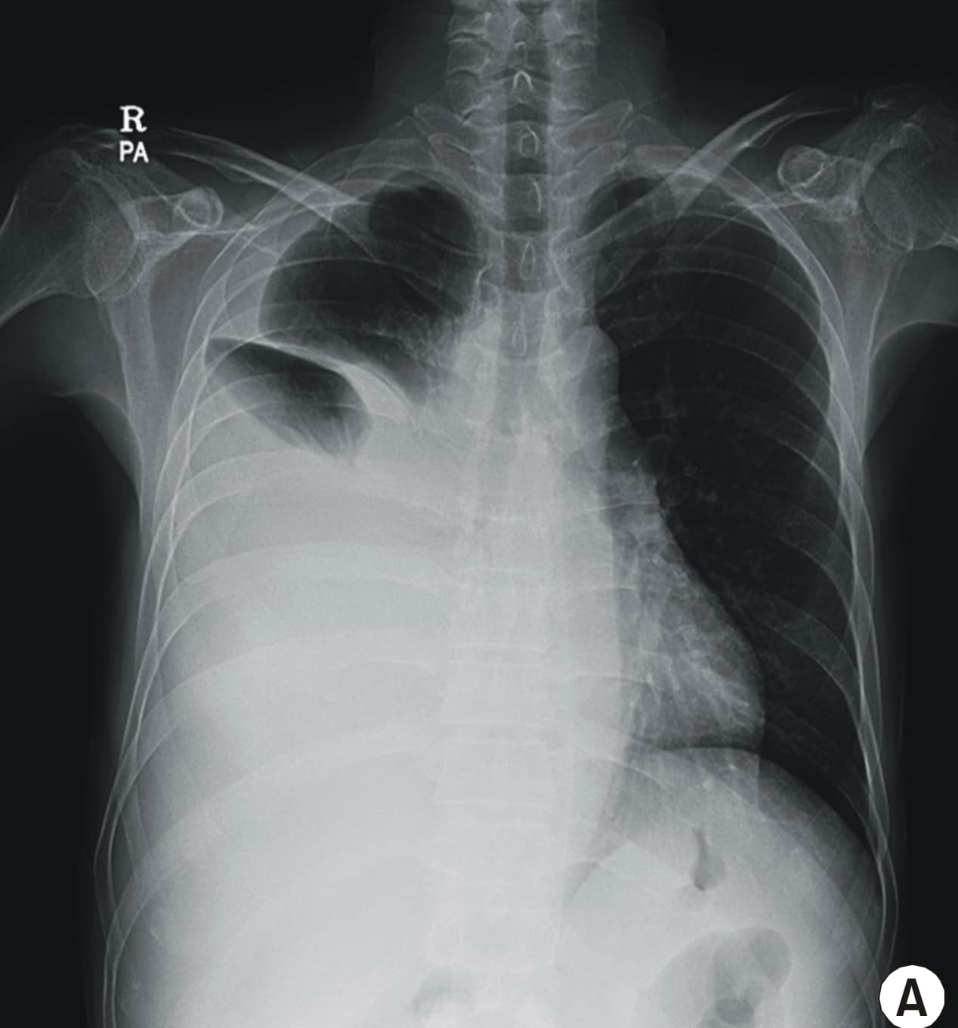
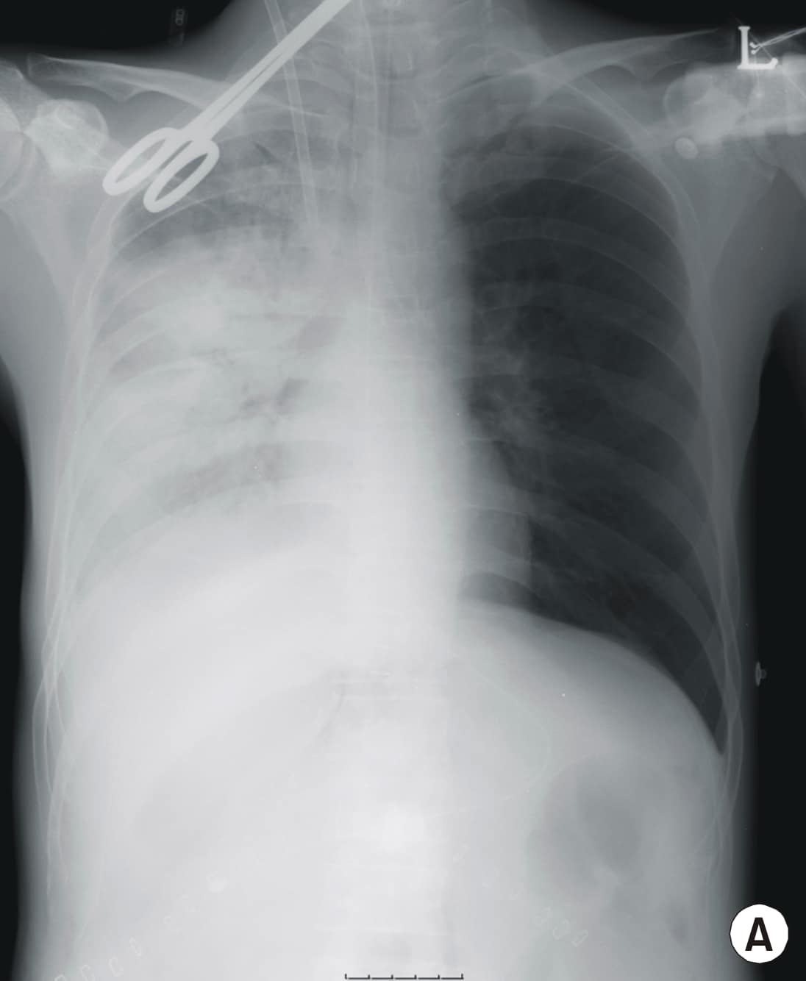
Respiratory
Restrictive Lung – Ascites
Hepatic hydrothorax( 5-10%)
Pleural effusion (usually >500 mL) in a patient with cirrhosis after R/O cardiac, pulmonary, or pleural disease.

Slide 8
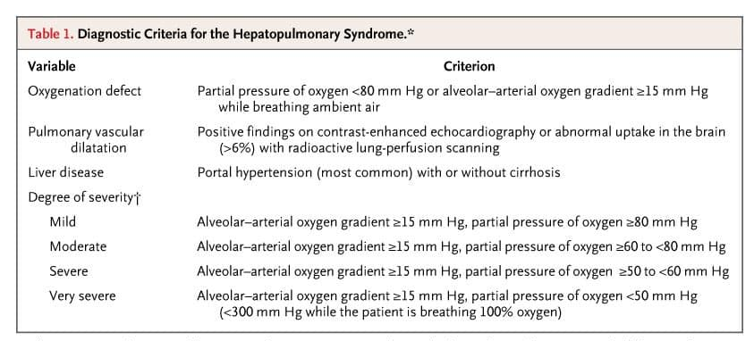
Respiratory
Hepatopulmonary syndrome
Rodríguez-Roisin R, et al . N Engl J Med 2008;358:2378-2387

Slide 9
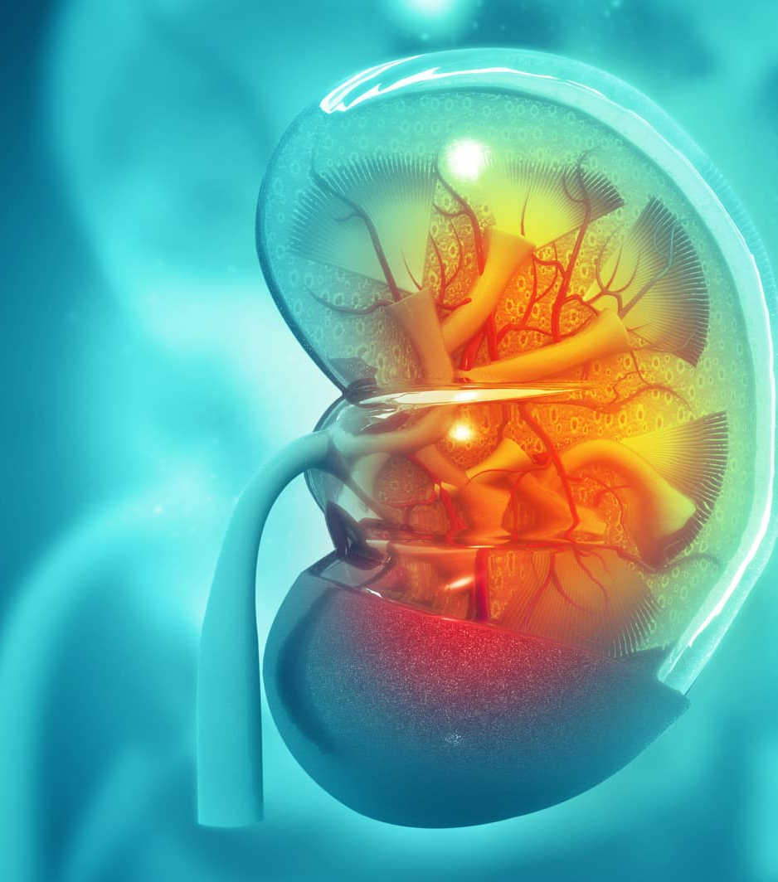
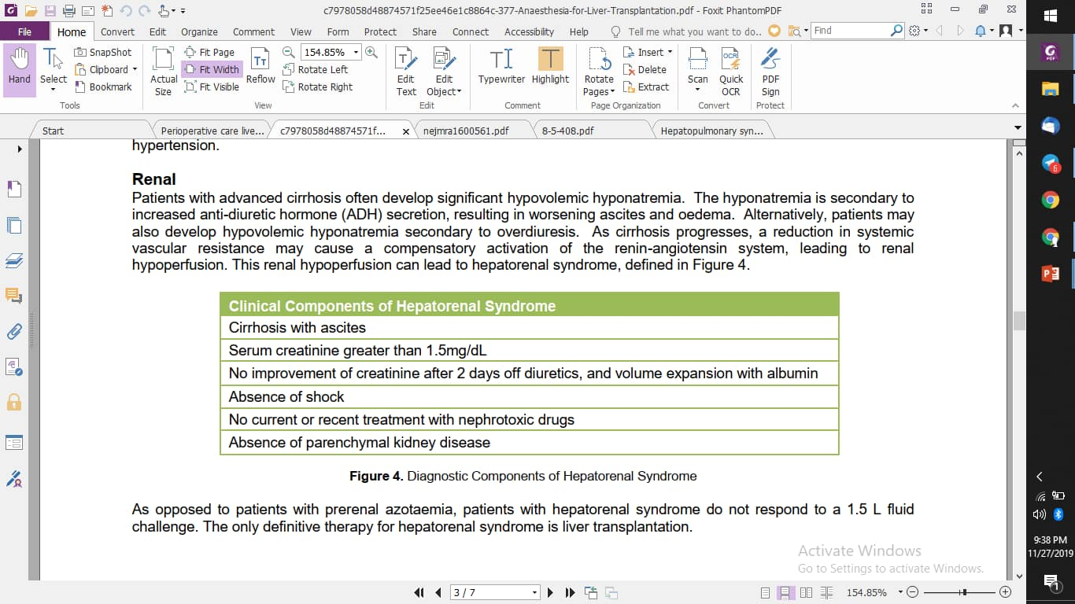
Renal
Hepatorenal Syndrome

Slide 10
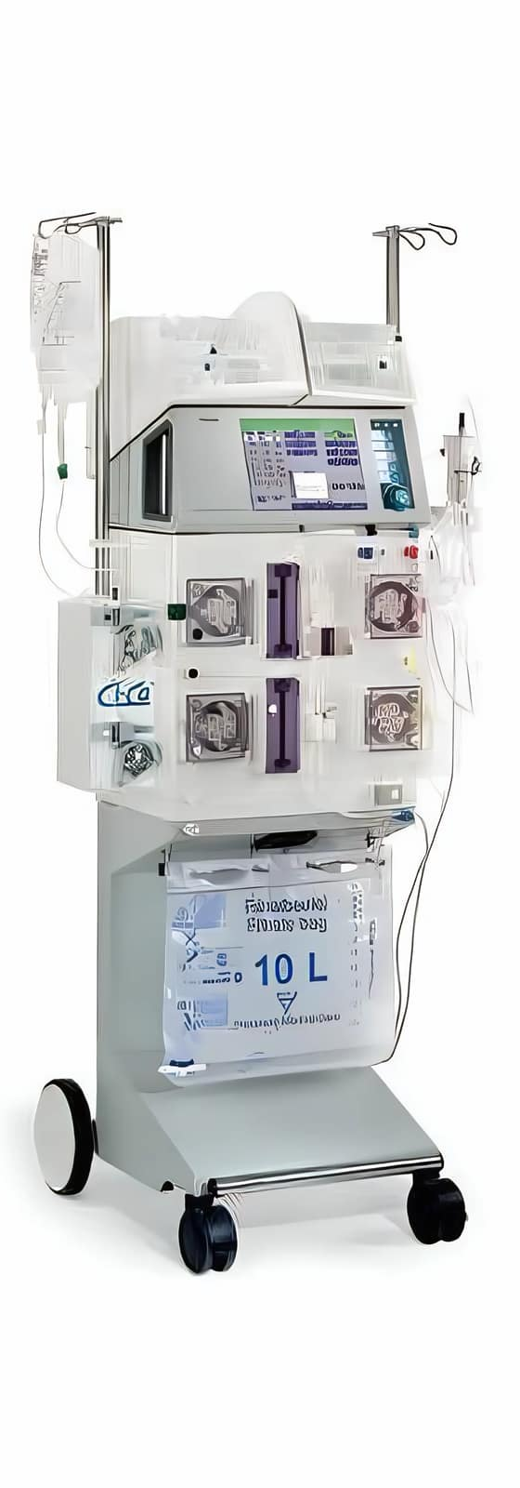
Renal
CRRT

Slide 11
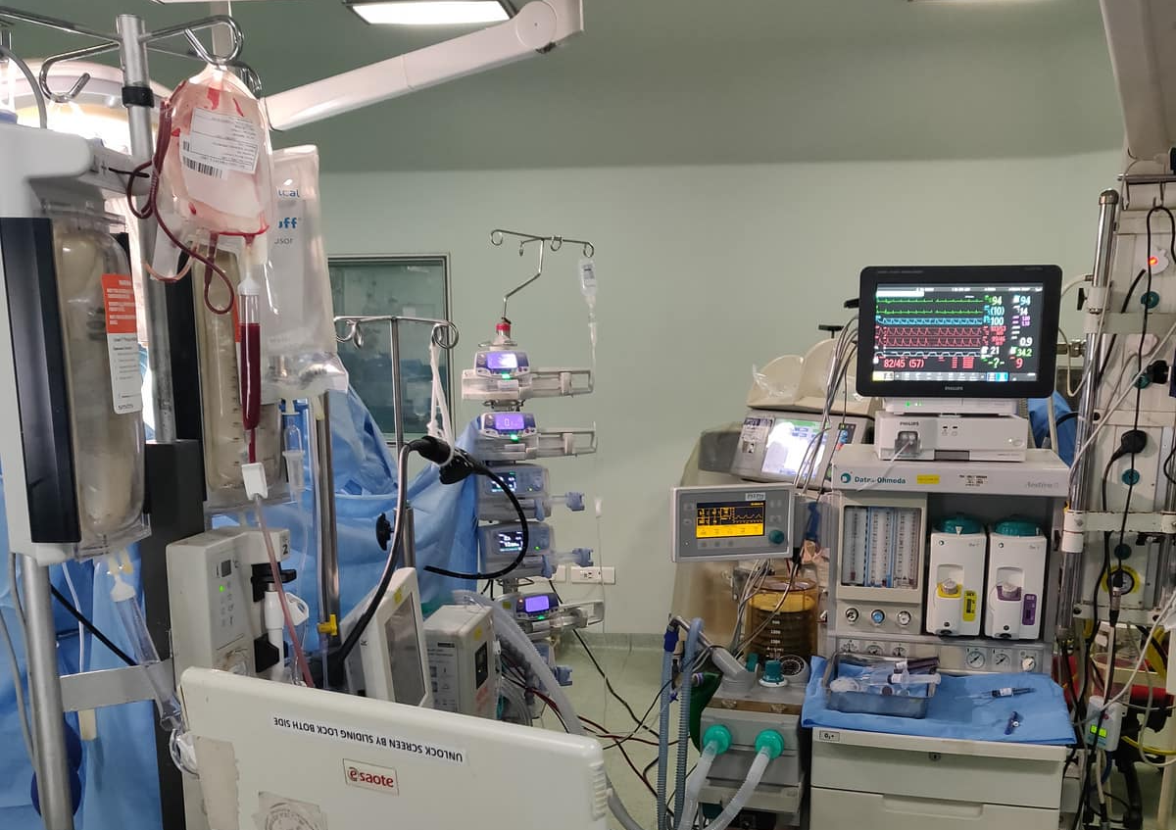
Anaesthetic Induction
GA with peripheral access- awake art line in some
CVC, Mac / Vascath
Femoral arterial line- venous line for monitoring

Slide 12
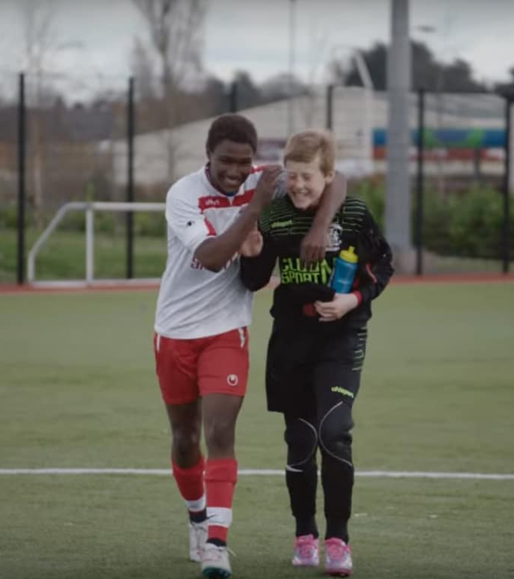
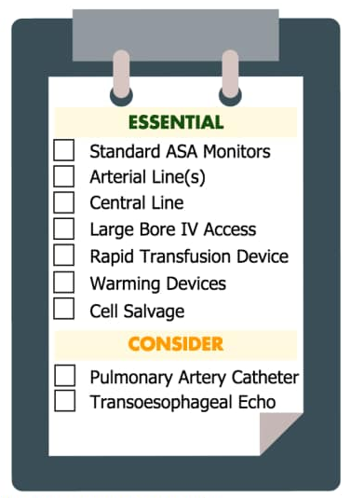
Monitoring

Slide 13
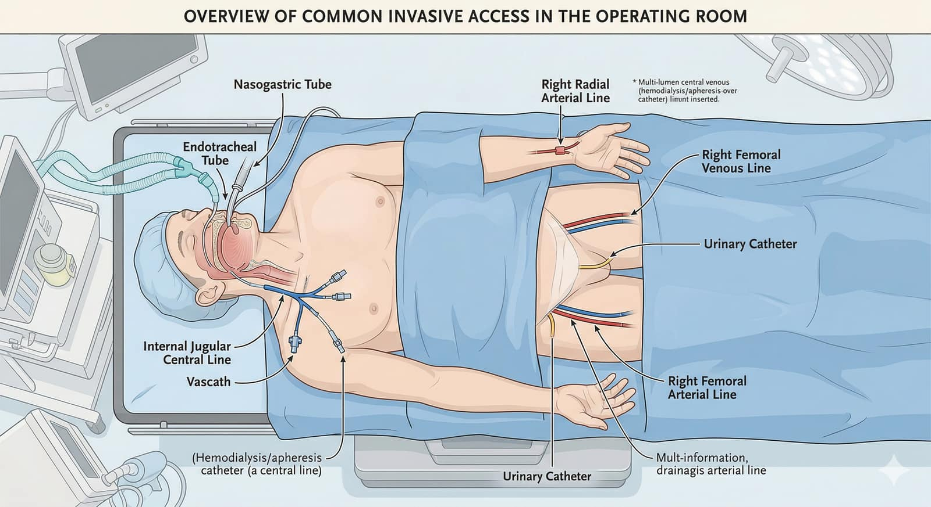
Monitoring

Slide 14
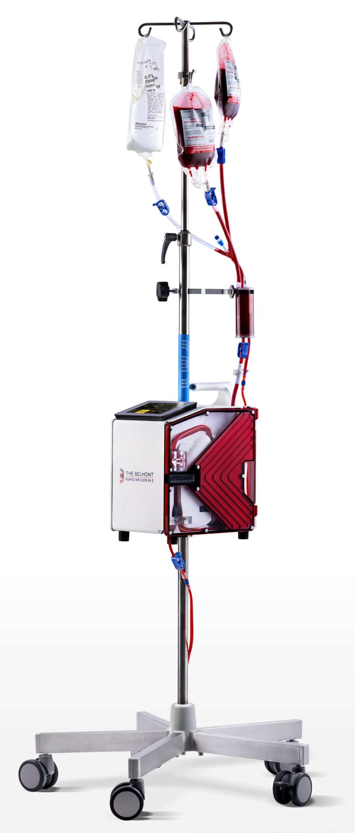
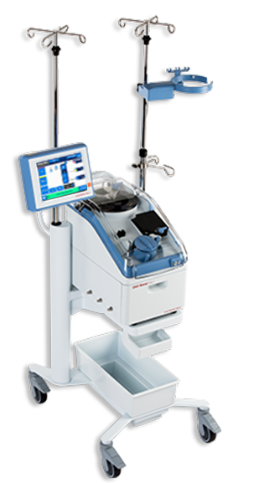
Belmont Rapid infuser Cell Saver

Slide 15
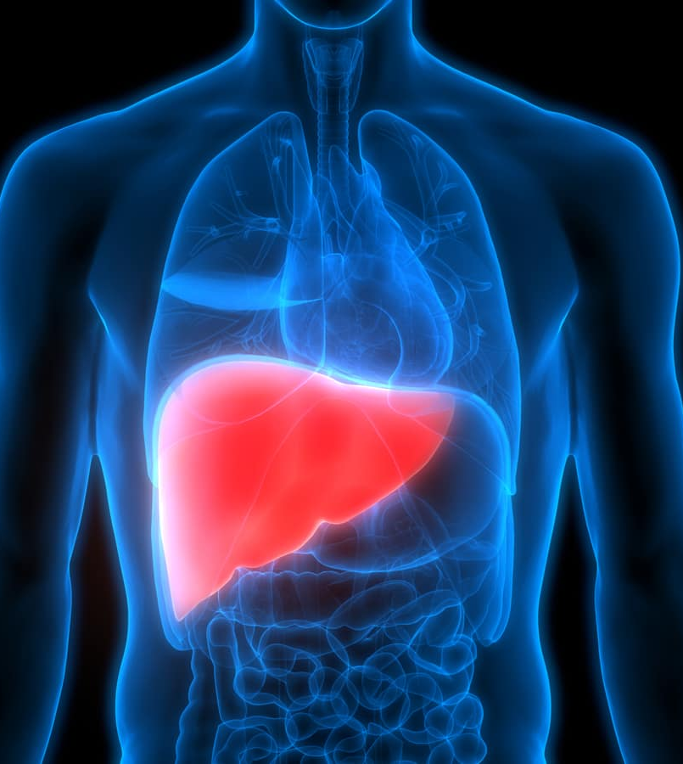
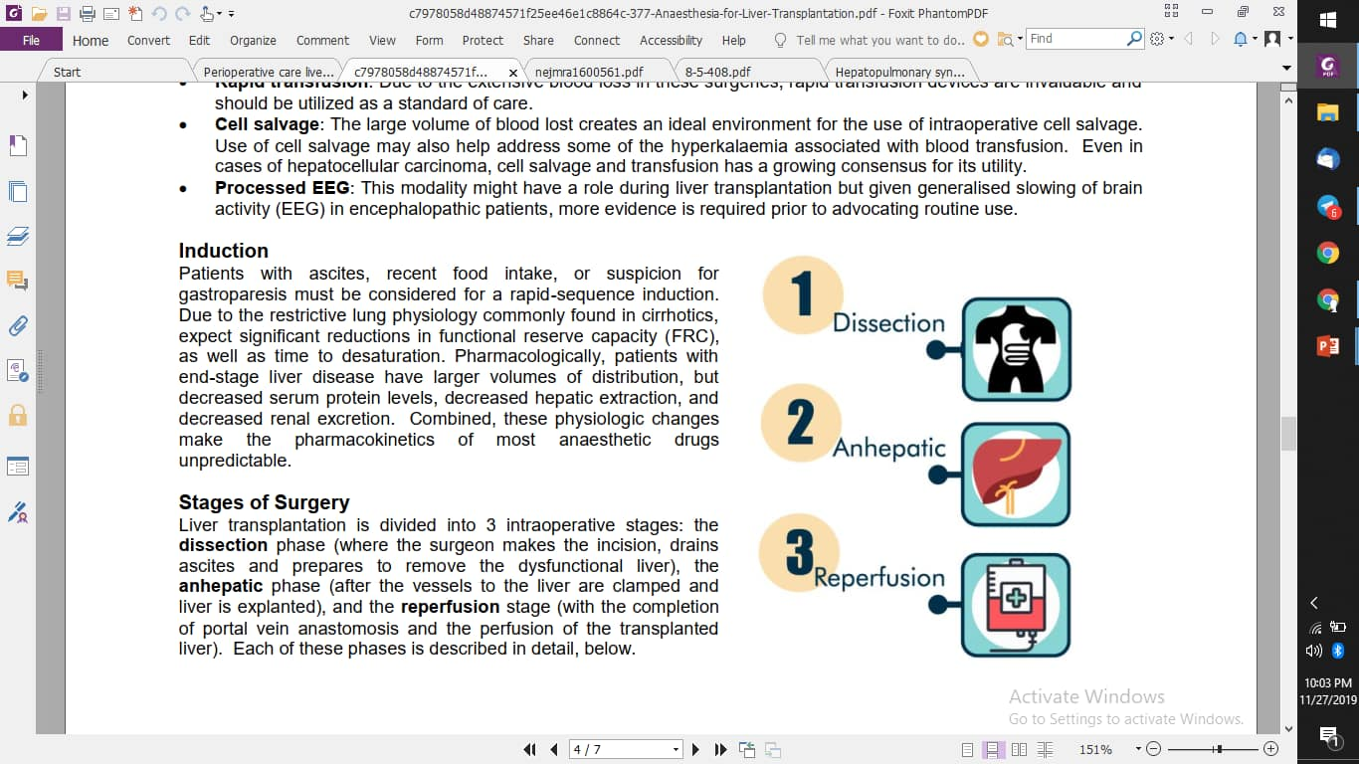
Monitoring

Slide 16
Hemodynamics
Coagulopathy - TEG
Electrolytes
Rapid ascites removal
Monitoring
Incision → clamping of the hepatic vessels

Slide 17
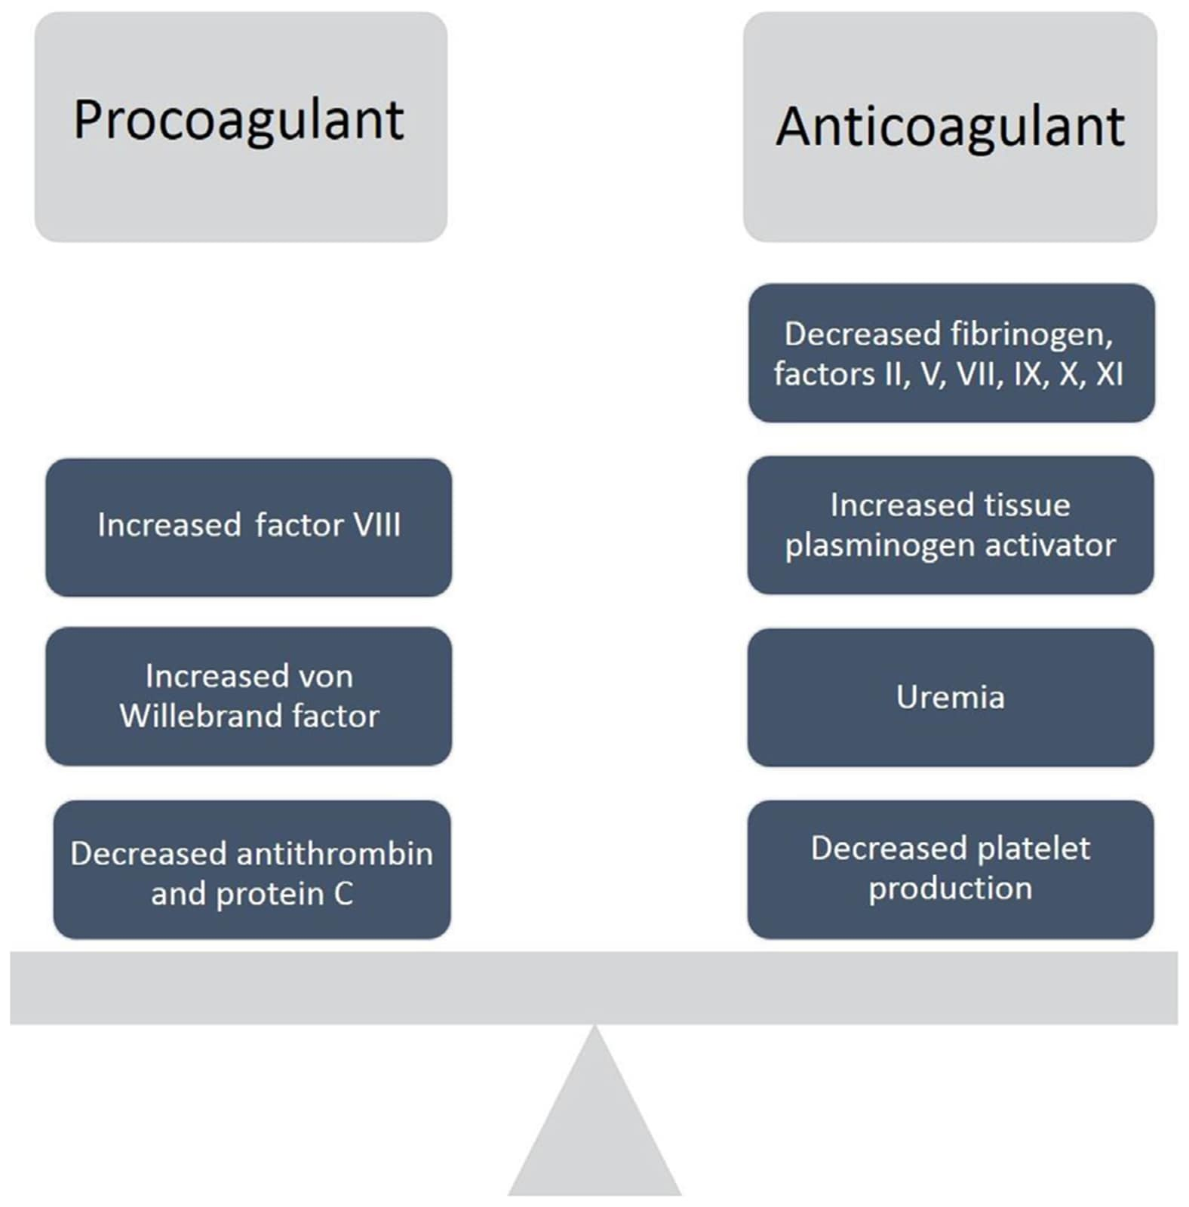
Perioperative Coagulation
Dynamic
TEG + Surgical bleeding
Less is more- till its not!!

Slide 18
Management principles for bleeding
Temperature
Calcium
Reversal of heparin/warfarin
Cryo/Fibrinogen
FFP
Platelets
Surgeon
Stop the bleeding
Now
DDAVP(case reports)
Tranexamic acid

Slide 19
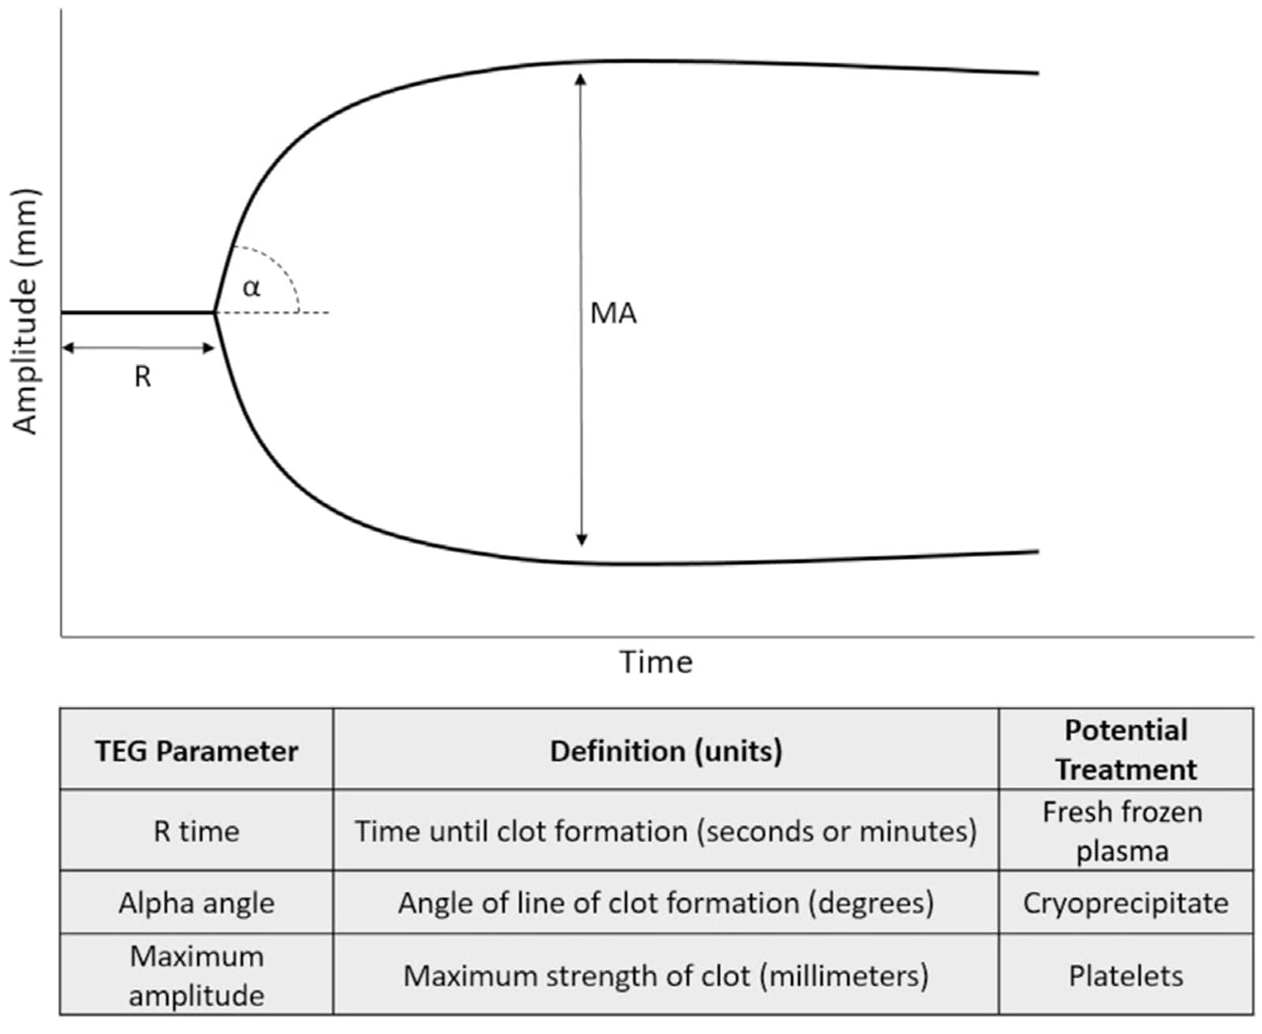
Perioperative Coagulation
Dynamic
TEG + Surgical bleeding
Less is more- till its not!!

Slide 20
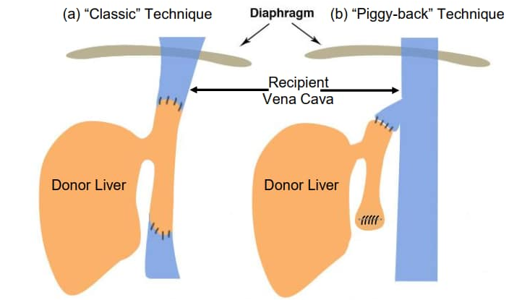
Classic
Extreme preload loss
Volume loading
Vasoactive meds
Calcium homeostasis
Piggyback
Better preserved preload
Lesser instability

Slide 21
Hypotension
Fluids- Vasopressors
Acidosis
Bicarbonate infusion(pH)
Hyperventilate briefly
Hyperkalemia
Hypocalcemia
Insulin/Glucose, Bicarb
CRRT
Coagulopathy worsens
TEG/ Surgical field
Use TOE, CVP, gases, UO, CO monitors/PPV
Blood if needed
Monitoring
removal of the native liver → re-anastomosis of the transplanted liver graft
prior to vascular unclamping and reperfusion

Slide 22
Monitoring

Slide 23
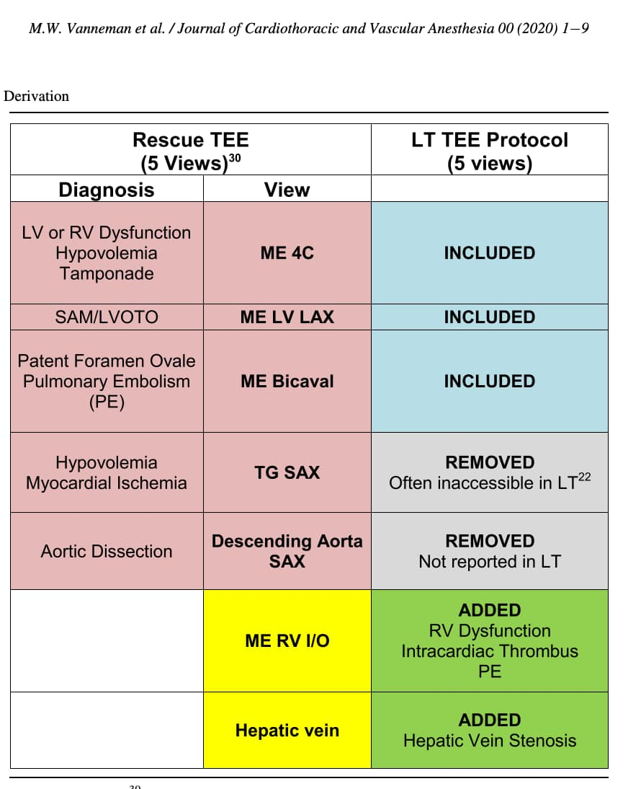
Perioperative TOE
Hypovolemia
right ventricular (RV) dysfunction
left ventricular (LV) dysfunction
intracardiac thrombus (ICT)/pulmonary embolism (PE)
SAM/ LVOTO

Slide 24
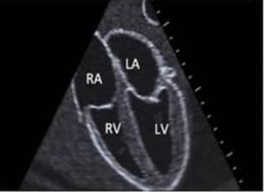
ME 4C (Mid-Esophageal 4 Chamber) | LV/RV Dysfunction, Hypovolemia, Tamponade

Slide 25
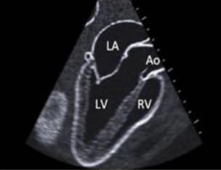
ME LV LAX (LV Long Axis) | SAM/LVOTO

Slide 26
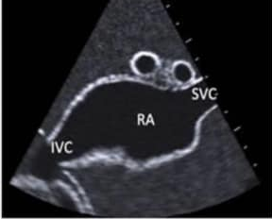
ME Bicaval View | PFO, Pulmonary Embolism

Slide 27
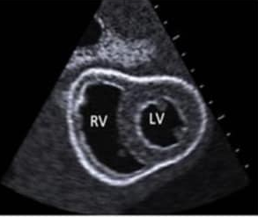
TG SAX (Transgastric Short Axis) | Hypovolemia, Myocardial Ischemia

Slide 28
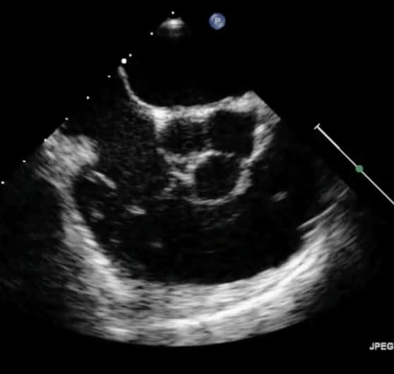
ME RV Inflow-Outflow | RV Dysfunction, Intracardiac Thrombus, PE

Slide 29
Portal vein unclamping
Cold, Desaturated/ acidotic blood
Post Reperfusion syndrome
30% decrease in MAP
Arrhythmias
Electrolytes
Defib pads
Il-6 and TNF alpha
Risk of right heart failure
Potassium
Prayers?
Monitoring

Slide 30
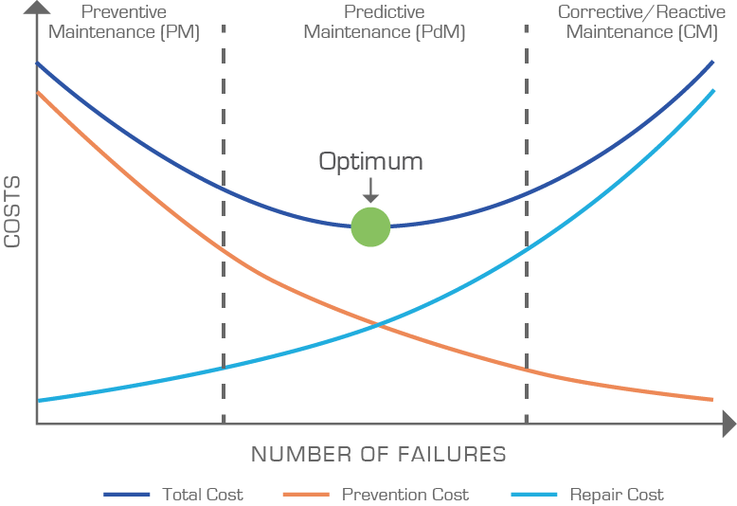
Metaraminol
Adrenaline 10 mcg bolus
Bicabonate bolus
Glucose Insulin
Fluid resuscitation
Preventive
Predictive
Reactive
Reperfusion Models

Slide 31
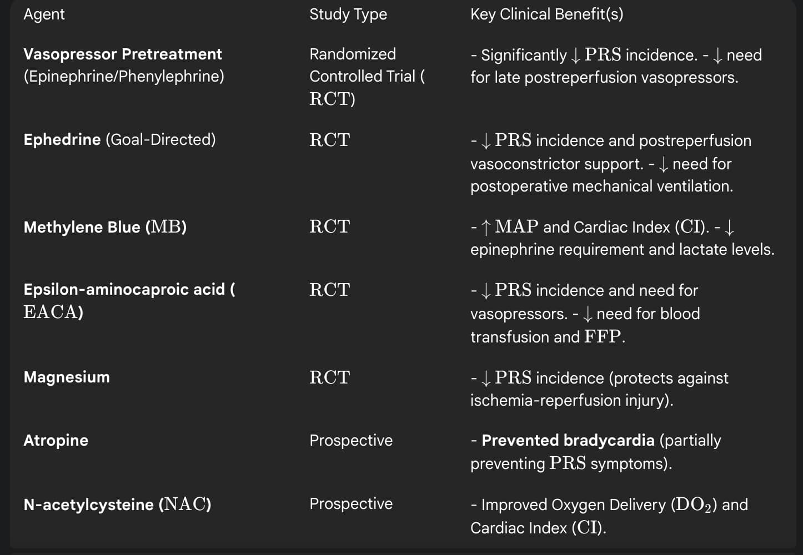
Methylene Blue
Hydroxycobalamine
REFRACTORY
Preventive
Predictive
Reactive
Reperfusion Models
Notes:
Adre, ephed,metaraminol, insulin dex, calcium,

Slide 32
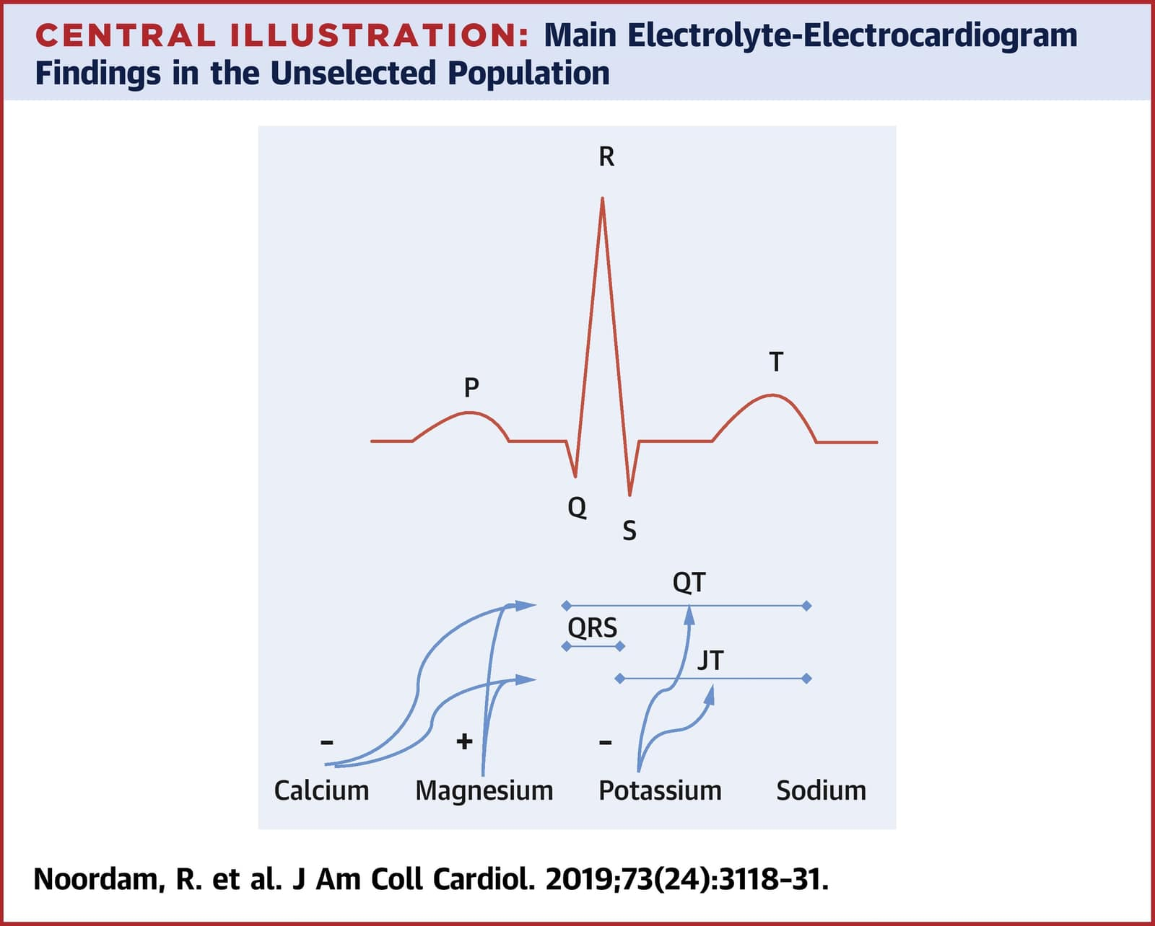
Perioperative electrolytes
Starting Hyponatremia– CPM
Blood transfusions- Calcium
Magnesium
Potassium- kidneys, HE!

Slide 33
Check before weaning
Graft function
Vasculature
Ultrasound/Doppler
patent hepatic and portal vasculatures
a rise in body temperature due to increased metabolism
hyperglycaemia from enhanced gluconeogenesis,
bile production,
normalization of coagulopathy,
lactate clearance
Monitoring

Slide 34
Anaesthesia for Liver Transplant
Dynamic Physiology Surgery Coagulation
Equipment TOE Belmont Cell Saver CRRT
Intensive Care On steroids☺

